Slide 1
Yashoda Girls’ Arts & Commerce College Sneh Nagar, Wardha Road, Nagpur Topic - Essay COMPULSORY ENGLISH

Slide 3
Types of Essay There are six types of essay Descriptive Essay Reflective Essay Narrative Essay Imaginative Essay Explanatory Essay Argumentative Essay
Unit IV Grammar
&
Composition
ESSAY

Slide 4
Descriptive Essay Describe (V) say --- a person or thing I like; Give a picture of someone/ something in words. Description (N) the act of writing or saying in words what someone / something is like. Descriptive (Adj) the one who/ that describes. Definition: the writer describes whatever he sees or hears about a person, place, thing or an animal. It is commonly of concrete /real natures. Examples: Person: a leader, teacher, doctor, and actress etc. Place: a country, city, village, town, school, college etc. Thing: A car, bus, watch, door, lock, flag etc. Natural things: snow, ice, rain, waterfall, the sky, the earth, sea etc. Animal: a cow, goat, horse, dog etc.

Slide 5
Reflective Essay
Reflect (V) to think deeply about, to contemplate, to considerate.
Reflection (N) thought, contemplation, consideration, meditation.
Reflective (Adj) thoughtful, contemplative, meditative.
Definition: In the reflective essay, the writer reflects on the topic. He forms different ideas and thoughts about topic in his mind, which is generally of an abstract nature.
Examples:
Philosophical topic: conscience, love, hatred, kindness, life etc.
Religious topic: death, soul, power of prayer, recitation of the holy Quran etc.
Social topic: dowry, divorce, marriage, poverty, slavery, liberty etc.
Merits and demerits: bravery, honesty, dishonesty, hospitality, discipline, unity etc.

Slide 6
Narrative Essay Narrate (V) to give a written or spoken detail of an incident, accident or adventure, etc. Narration (N) the act of giving a written / spoken detail of incident, accident or adventure, etc. Narrative (Adj) in the form of storytelling. Definition: the writer/author narrates an accident, incident, a journey, tour / historical event. Examples: An accident: Bomb blast, train or bus collision. Natural disaster: Earth quake, flood, fire. Incident: Street fighting, relative’s death. Any story actual or imaginary Journey, your, walk etc. Biography of a well-known personality

Slide 7
Imaginative Essay Imagine (V) to form a mental picture of something. Imagination (N) the act of imagining. Imaginative (Adj) showing imagination, full of imagination. Definition: In the imaginative essay, the writer imagines about a topic. Examples: If I were you… If I were rich… If I were a king… If I were the P.M of India… ‘What would you do?’ If I were you, I would …

Slide 8
Expository/ Explanatory Essay Expose (V) to explain Exposition (V) explanation Expository (Adj) explanatory Definition: the writer/author explains / exposes the topic. Examples: Industries: Sugar mill, cotton mill, flour mill etc. Departments: senate, parliament Occupation: medical, engineering, etc. Scientific: functioning of TV, radio, wireless, telephone, fax, computer Quotations / sayings: mother is the first teacher, if there is a will, there is a way.

Slide 9
Controversial/ Argumentative Essay
Argue (V) to give reasons (for or against something). Argument (N) reasons (for or against something). Argumentative (Adj) Controversial / debated Definition: the writer / author argues for and against the topic.
Examples:
Who is responsible for the down fall of education?
Love marriage or arrange marriage.
Village life or city life.

Slide 10
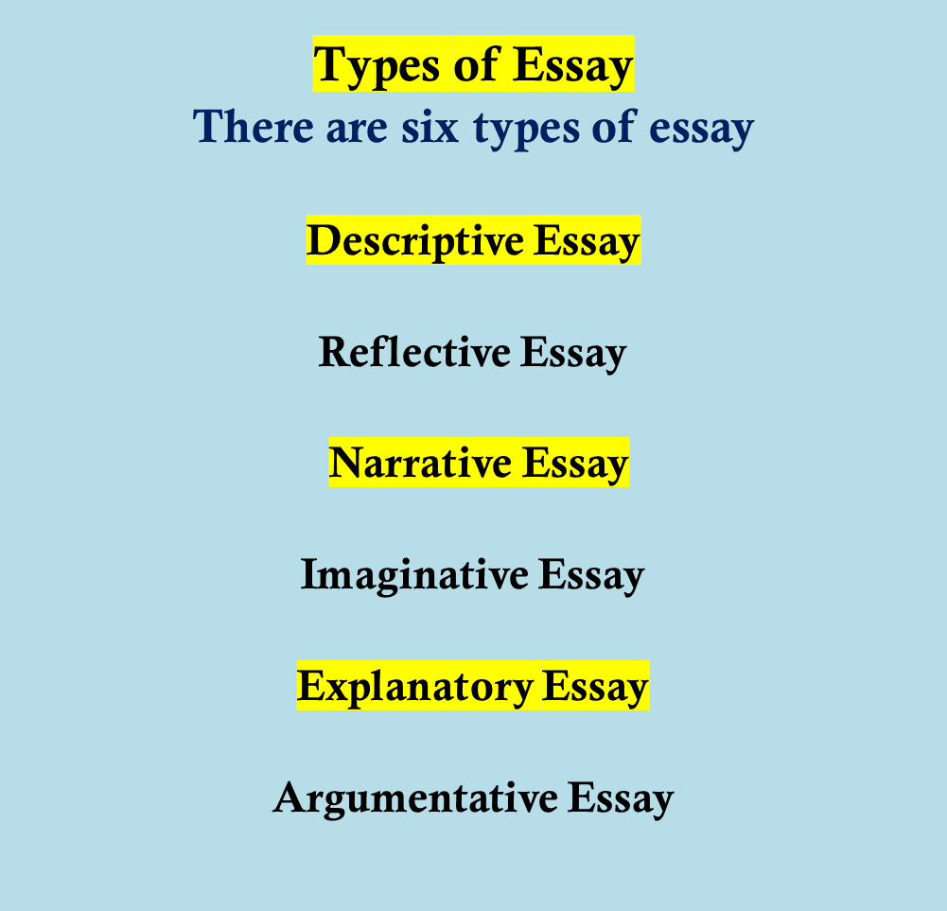

Slide 11
Thanks amolsaroj2020@gmail.com 9822277497

