Slide 1
DEPARTMENT OF SOCIOLOGY
Presented By
Dr. Prakash Sonak
Head
Department of Sociology

Slide 2
.
ch-,- }hrh; ;qfuV & 1 lsehLVj & 3
Qzsap jkT;Økarh
(French Revolution)

Slide 3
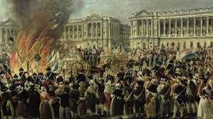
.

Slide 4
Ýsap jkT;Økarh 1789
Ýsap jkT;Økarh gh tkxfrd bfrgklkrhy ;qxizorZd ?kVuk
Ýsap jkT;Økarh us rhu oSf’od eqY;s ekuoh lektkyk fnyh
Lokra++++«;
Lkerk
ca/kqrk

Slide 5
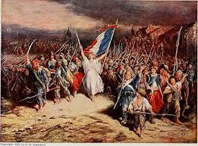

Slide 6
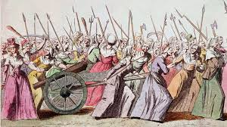

Slide 7
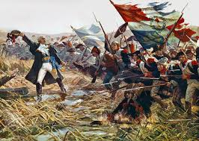

Slide 8
5 es 1789 OglkZ; yksdlHkk vf/kos”kukr loZlkekU; tursP;k ekx.;k
jktkus vkiY;k tqyeh o vfu;af=r lRrsoj fu;a=.k ?kkykos
O;fDrLokra+= izR;sdkyk feGkys ikfgts vkf.k r”kh jkT;?kVuk r;kj dj.;kr ;koh
loZlkekU; tursPkh lHkk fu;fer ?ks.;kr ;koh
loZlkekU; tursP;k lHksyk dk;nk laer dj.;kps vf?kdkj feGkys
dj clforkauk loZlkekU; tursP;k lHksph laerh ?;koh
Lkektkrhy loZ oxkZoj leku dj vkdkj.;kr ;kok

Slide 9
Ýsap jkT;Økarhps ifj.kke
Lakjtke”kkgh O;oLFkk u"V >kyh-
f[kzz”pu /keZlaLFksps vf/kdkj jÌ dsys-
/keZxq:aps fo”ks’k vf/kdkj u’V >kys-
/keZfujis{k 'kklu vfLrRokr vkys-
'kS{kf.kd ifjorZu >kys-

Slide 10
