Slide 1
TYPES OF VITAMINS
WATER SOLUBLE VITAMINS
FAT SOLUBLE VITAMINS

Slide 2
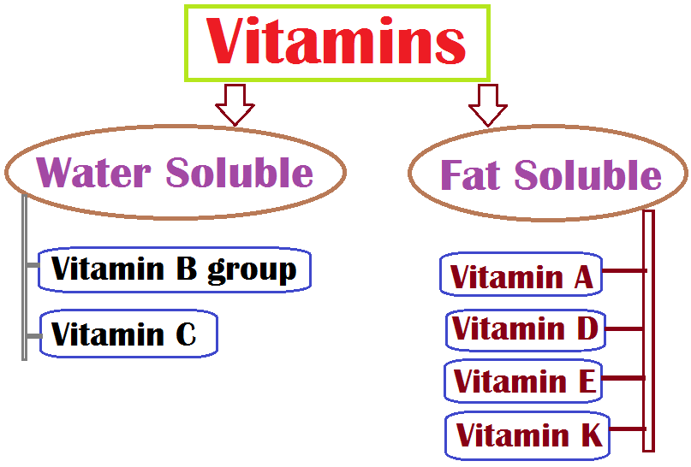

Slide 3
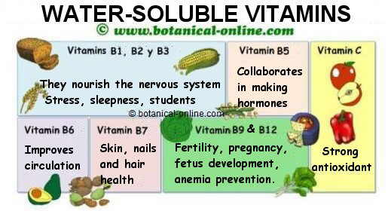

Slide 4
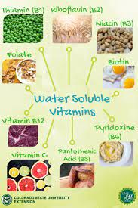

Slide 5
Deficiency of water soluble vitamins

Slide 6
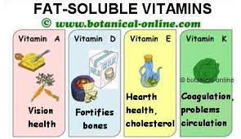

Slide 7
Deficiency of fat soluble vitamins

